Slide 1



For Psychologists
Dominique Makowski
D.Makowski@sussex.ac.uk
« A psychologist knowing GitHub »
Notes:
1h

Slide 2
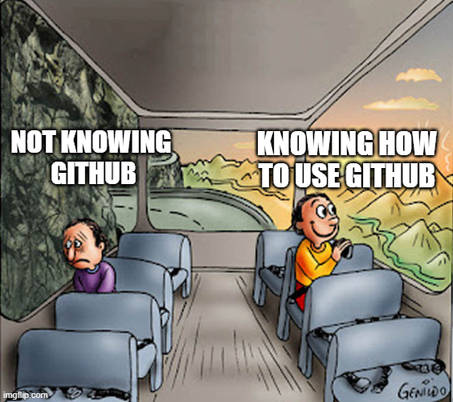
The Myth
« Github is for
programmers »
« Github is hard »
« I don’t have a reason to learn and use Github »
GitHub can be useful to anyone who wants to store stuff
GitHub does not need to be complicated (but can be)
You 100% do

Slide 3

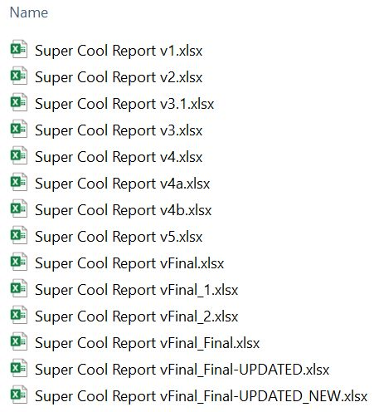


The Truth
What is GitHub even for?
Convenient to save your own stuff - cloud storage 🥳
Version control - never worry about losing anything 🤩
Great for collaborating on larger projects 🥰
Have websites 🤖
Host online experiments 👨‍🔬
Share your data and make your research reproducible 😇
Increase your open science rizz 😎
Develop networks and make friends 🤗
Get jobs 💰
All of this and more for free 🤯

Slide 4


The Bad
Steep learning curve… but why?
Idiosyncratic vocabulary
« commit » = save
« push » = upload
« pull » = synchronize
« fork » = copy
« clone » = local version
…
Online help is VERY confusing
Oriented to programmers
Interacting using command lines from the terminal
Emphasis on features that psychologists don’t really need (e.g., focused on co-developping large codebases)

Slide 5
Part 1
Basic Interaction with GitHub

Slide 6


Slide 7
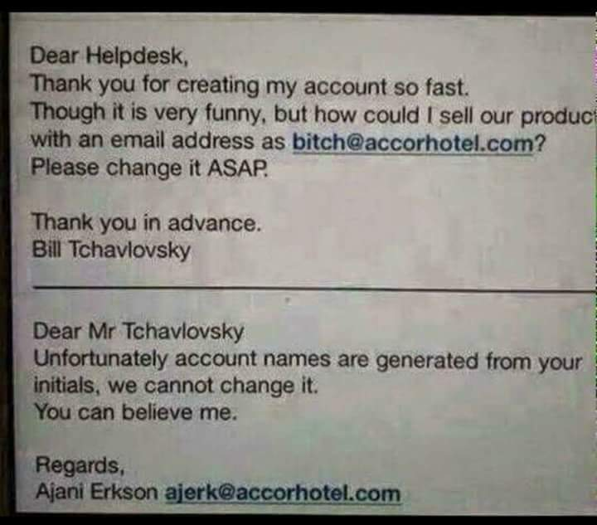
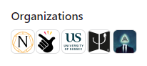
GitHub Account
GitHub requires an account, that has a username
Professional user name: FirstnameLastname
No dashes, CamelCase
Easy to remember
Easy to find / google
Easy to link your research outputs (papers) to your « GitHub » content
Important: your account name will be part of all your project names
“github.com/RagingAlcoholic/MySeriousResearchProjectRecruitersWillSee”
Note: accounts exist for users and organizations.
E.g., DominiqueMakowski vs. Reality Bending Lab

Slide 8
Hands-on!
Head to GitHub.com and create a new account

Slide 9
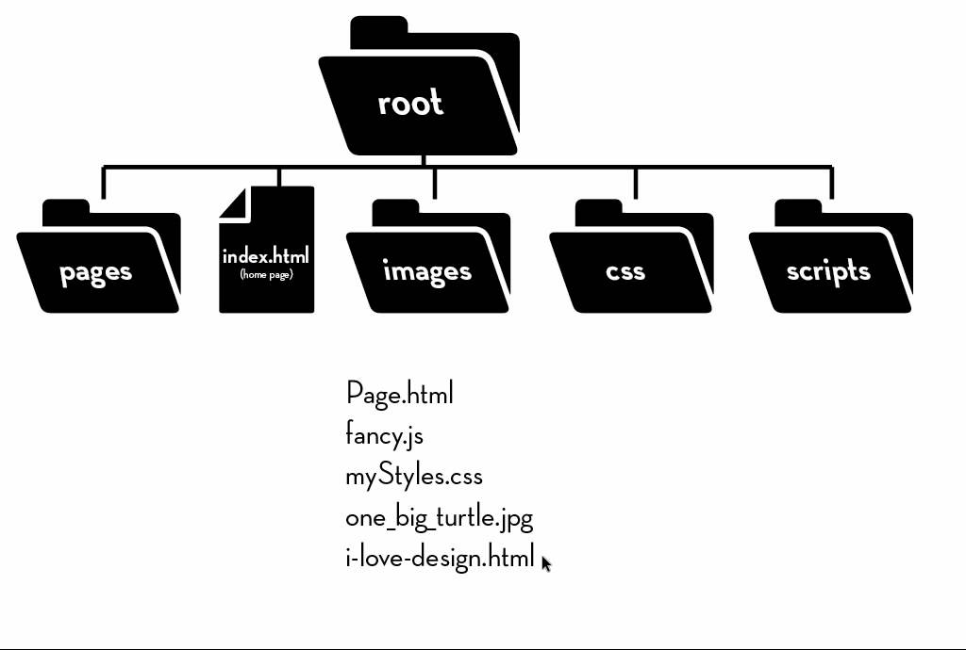
Repositories
A repository (« repo ») is an (online) folder
It can contain anything and any type of files
Particularly useful for files with « textual content »
Limit of 100 mo per file
Very large datasets should be split
(data_part1.csv, data_part2.csv)
Limit can be worked around (GitHub LFS)
It has a « root », and from there one can navigate to files and folders
Every file/folder has a « path »
e.g., « github.com/UserName/RepoName/folder1/file.docx »

Slide 10
Hands-on!
Navigate to the repo “RealityBending/FakeArt”
Navigate to data/
Open data_participants.csv

Slide 11
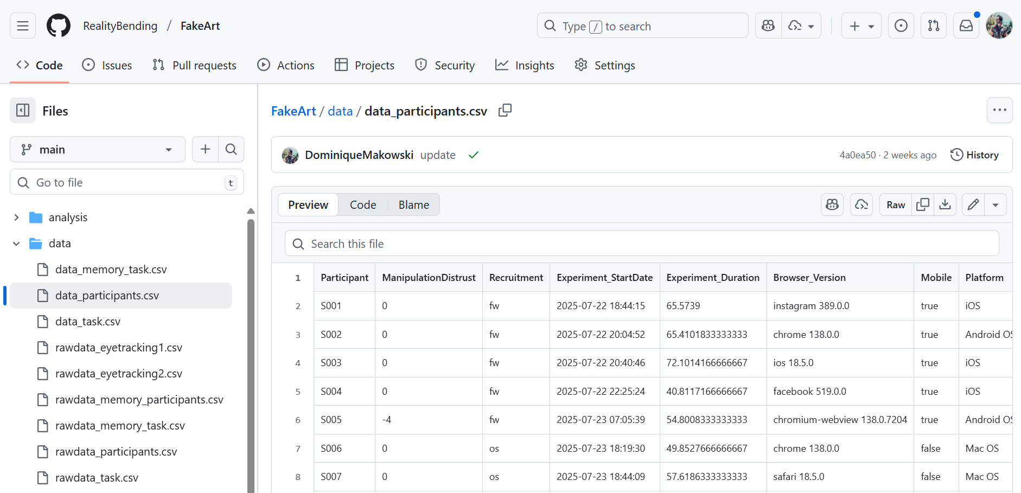
Downloading files
You can download any file by clicking the « download » button
Very useful when you want to download some specific content from a repo
Important: csv files (“comma-separated values”) are the most common, flexible, and transparent data format.
Best for Open Science
Avoid proprietary formats (.sav, .xlsx, …)

Slide 12
Hands-on!
Download data_participants.csv
Save it on your computer as “mydata.csv”

Slide 13
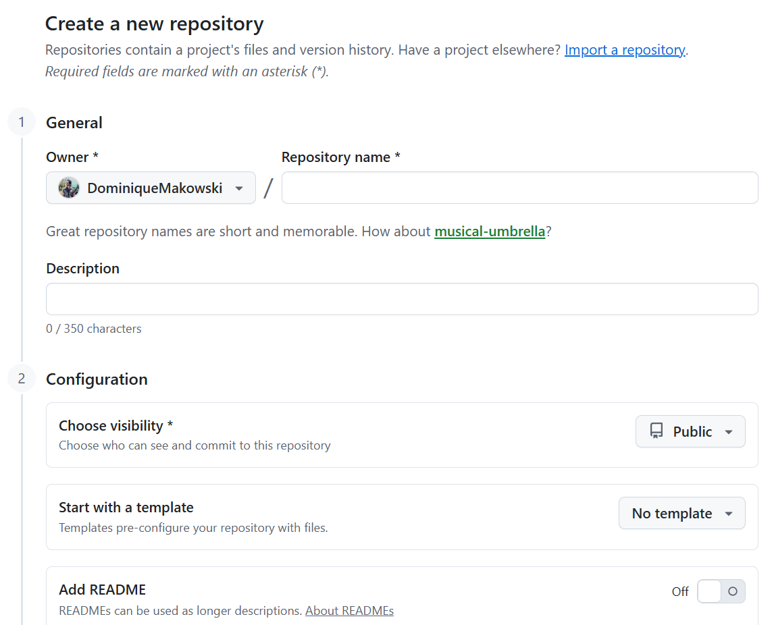
Creating Repos
You can create as many repos as you want
One per study or project
Name
Informative names
JohnDoe/proj7_kg-xbcb
JohnDoe/PersonalityScaleValidation
CamelCase vs. snake_case vs. kebab-case
Be consistent
A project can be renamed / deleted
Visibility
Private vs. Public
You can have private repos (with restricted access)
You can make a private repo public at any time (or never)
Default files
README: Adds a README.md file to the root (useful)
.gitignore: Used to « hide » files/folders from github (advanced)
License: Used to specifiy a license (can ignore)

Slide 14
Hands-on!
Create new repository
Name it for instance “FirstRepo”
Tick “add readme”

Slide 15
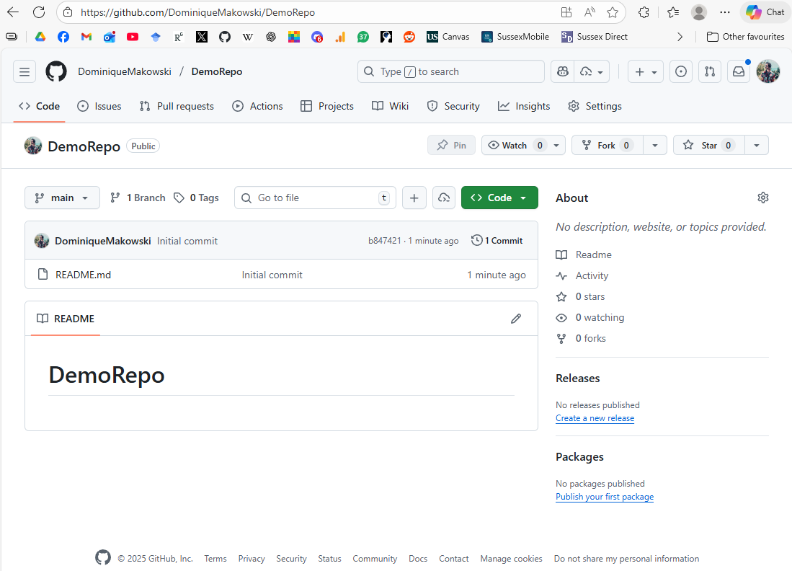
Structure
Content
List of folders & files
README
Landing page displays the content of the README.md file
Path
Notice the URL: UserName/RepoName
Navigation
Navigate to other aspects of the repo
Issues (useful to ask questions / report bugs)
Pull Requests (PR)
Actions [advanced]
Projects (roadmaps, to-do lists etc)
Wiki (dead)
…
Settings

Slide 16
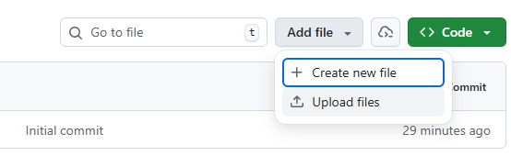
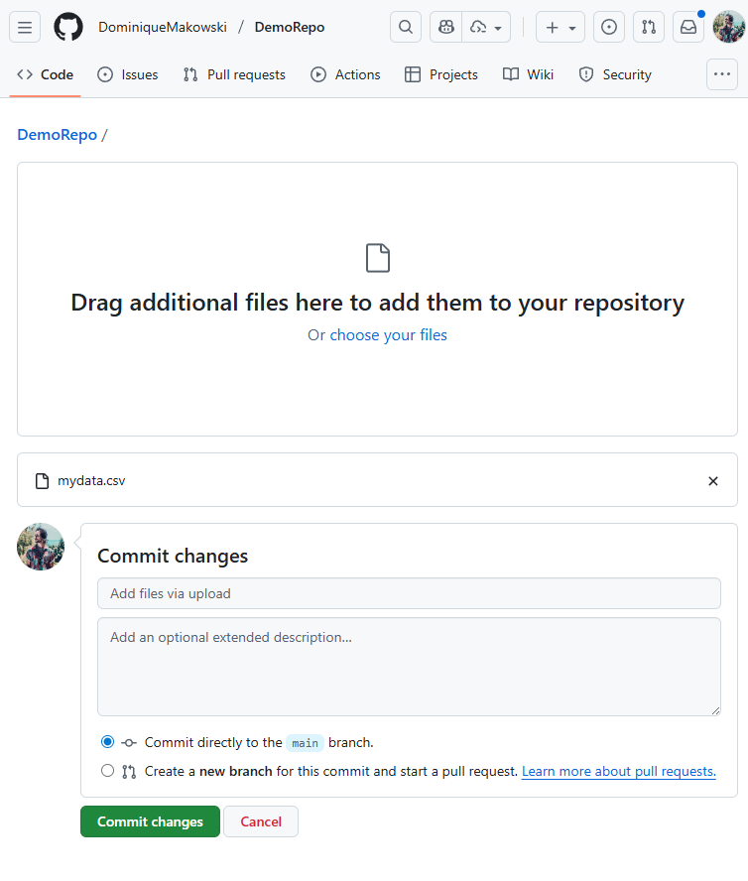
Uploading files
Uploading
The simplest way of adding things to your repo is via direct upload
Commits
Commits = updates
Commits can contain multiple changes in multiple files
Each commit must have an informative name (short description)
Each commit can have a more extended description
Main / master branches
Each repo can have multiple parallel versions (branches)
The main one is called « main » (or « master » on older repos)

Slide 17
Hands-on!
Upload some data at the root of your repo
Add file
Upload files
Drag & drop
Add informative name and description
Commit to main

Slide 18
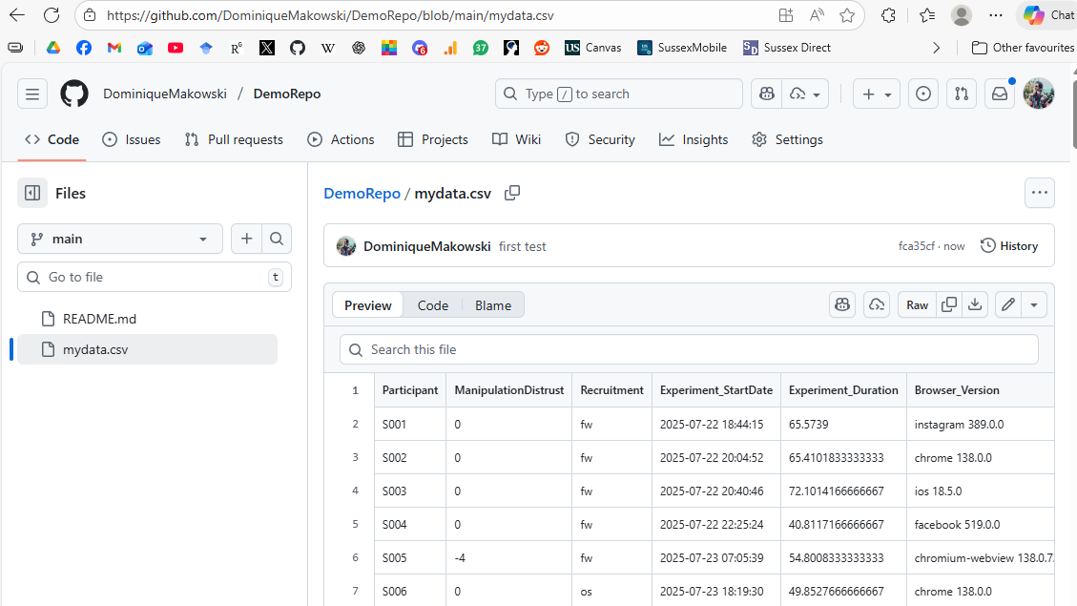
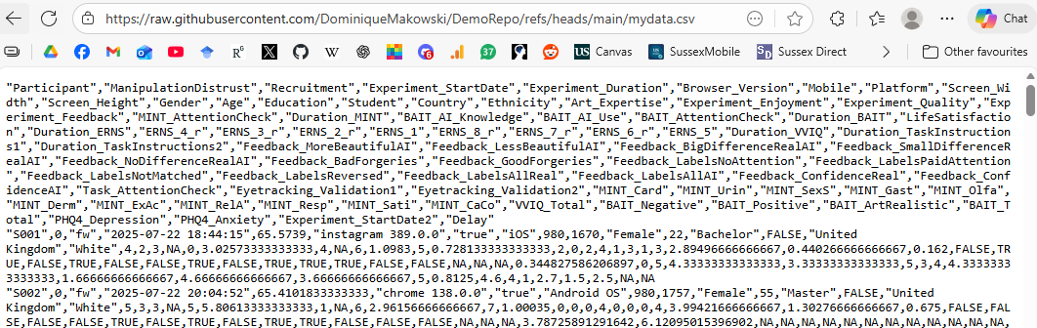
GitHub view vs. Raw view
GitHub view
When opened in GitHub, most files are opened « within GitHub »
The URL is not the URL of the file itself, but of the file embedded within the repo
Raw view
One can also get the « raw » view
The URL is now that of the file itself
The file’s content is diplayed (as if you opened it with a text editor)

Slide 19
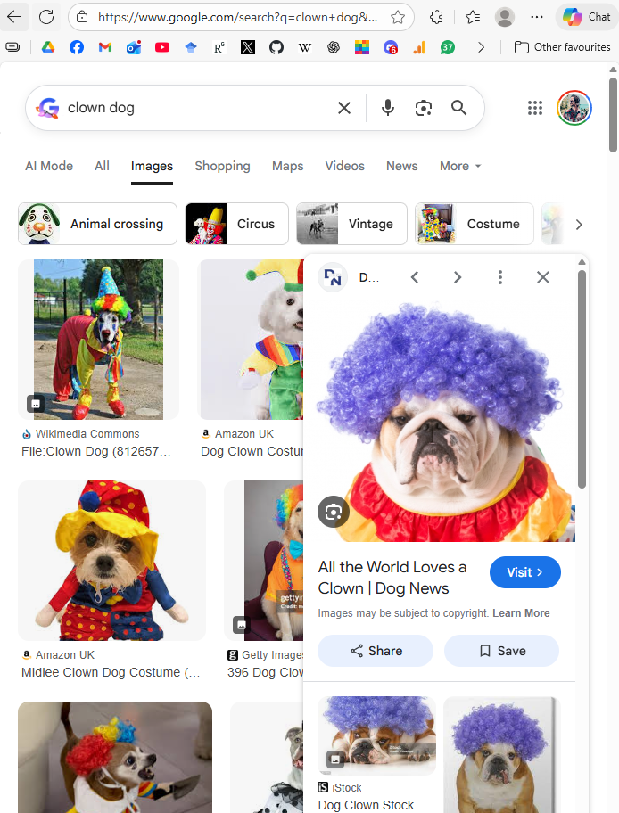
Hands-on!
Upload an image on your repo
Your favourite animal
Bonus points if disguised as a clown
Name it “mypic.png” (adapt the extension accordingly)
Check the GitHub view vs. the Raw view
Note: for images, no “raw” button, instead: RIGHT CLICK -> Open image in a new tab

Slide 20
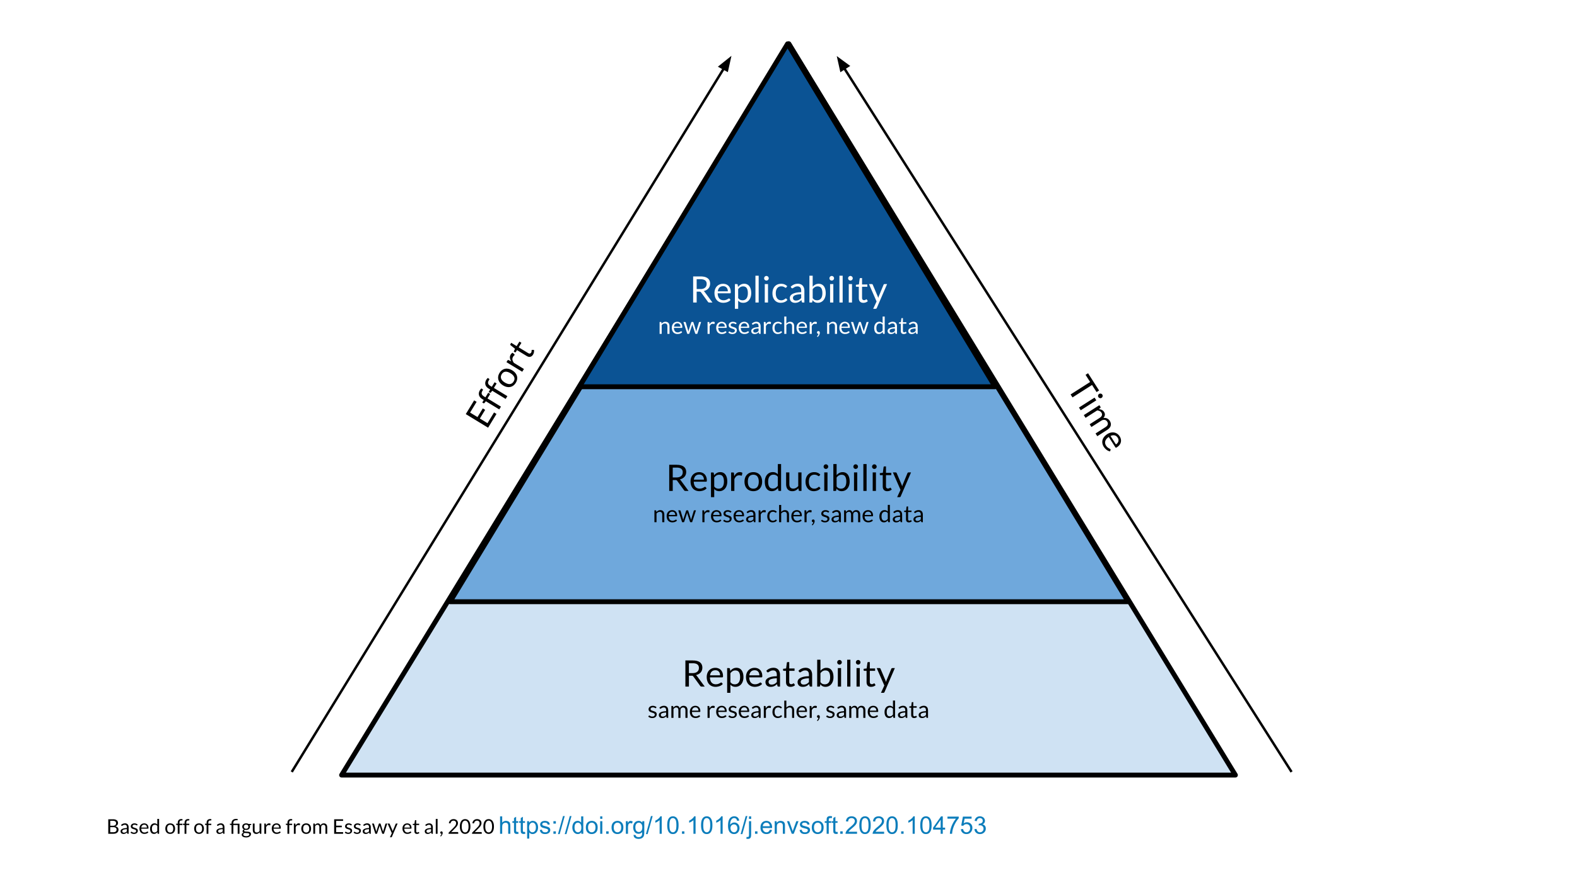
Reproducible Research
What is the raw file URL useful for?
Most good data analysis software can load data from the internet
It can be used to make your analysis script FULLY reproducible
Anybody can simply run the script as-is, it does not require any local resources or setup (some files in a particular folder etc)
Useful for yourself: don’t need to bother with data management, can work from anywhere (don’t need to have the data file on your system)

Slide 21
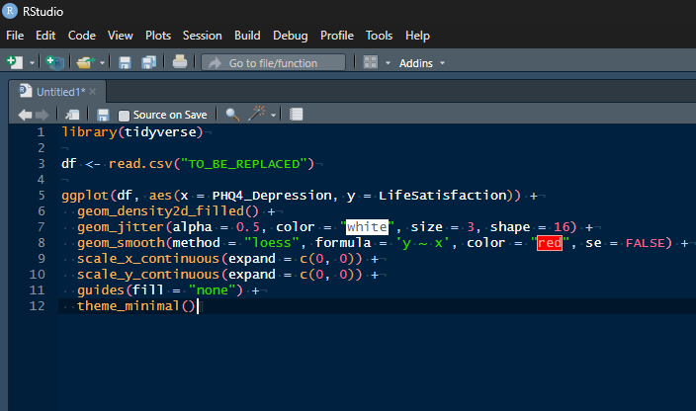
Hands-on!
Open R Studio
Navigate to “analysis.R” in DominiqueMakowski/DemoRepo
Copy that code and paste it in an R script
Get the URL of the raw data file of your repo
Put that URL as data path in the code
Run the code

Slide 22

Summary
Basic interaction with GitHub (file downloading, uploading) can be done via GitHub.com
You can easily make an online space to store research material
These resources can be shared (even with non-GitHubbers)
Enables a reproducible analysis workflow

Slide 23
Part 2
Hosting websites with « GitHub Pages »

Slide 24


What is a website
Webpage is an html file
Contains html code
Can contain embedded css and javascript (js) code
It is diplayed as a webpage when opened via a web browser
But you can open the code itself by opening it with a text/code editor
The default landing is typically named index.html
Websites are just code. You know what is good at generating code?

Slide 25
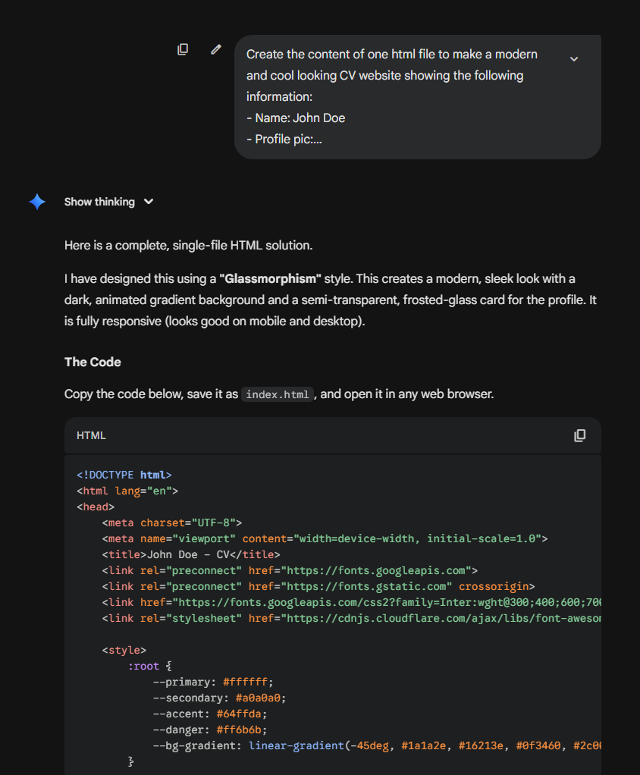
Hands-on!
Create the code of a website:
Create the content of one html file to make a modern and cool looking CV website showing the following information:
- Name: John Doe
- Profile pic: [RAW URL OF THE PIC IN YOUR REPO]
- Born: 25/12/2000
- Education: Hogwarts High school (2019-2023); Sussex University (2023-present)
- Skills: Psychology background, statistics in R, a bit of Python
- Things I like: Football, sci-fi movies, craft beers
- Things I don’t like: Running, rude people

Slide 26
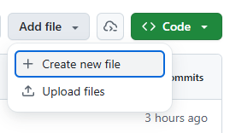
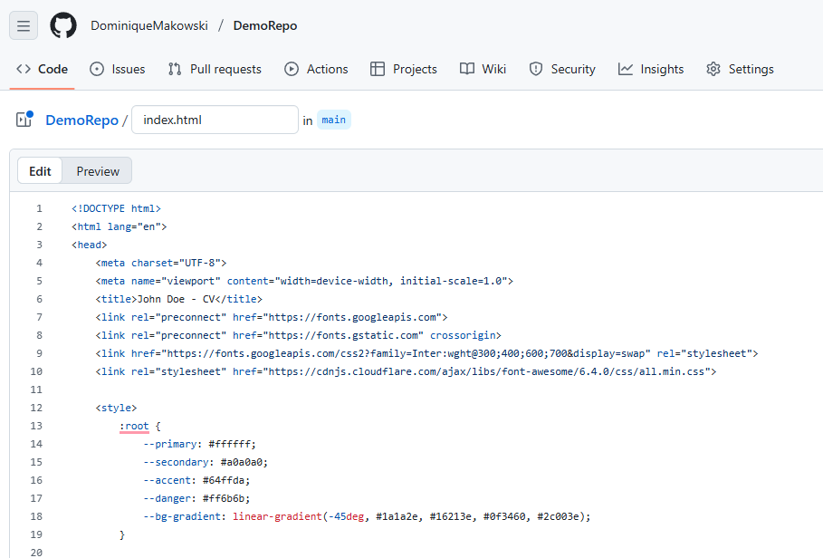
Hands-on!
2. Make an index.html file on your repo
Add file
Create new file
Paste the html code
Name the file “index.html”
Commit
2. Viewing the file (github view & raw view)

Slide 27

Github Pages
Github displays html files as a file with code content (as they are)
We can enable a website view of the repository, which can be used to view html files as webpages
This feature is called « Github Pages »
For any folder (including the root), the web view will look for an « index.html » file to land on (unless a specific html file is specified)
https://realitybending.github.io/ = https://realitybending.github.io/index.html
https://URL.github.io/docs/specific_page.html

Slide 28
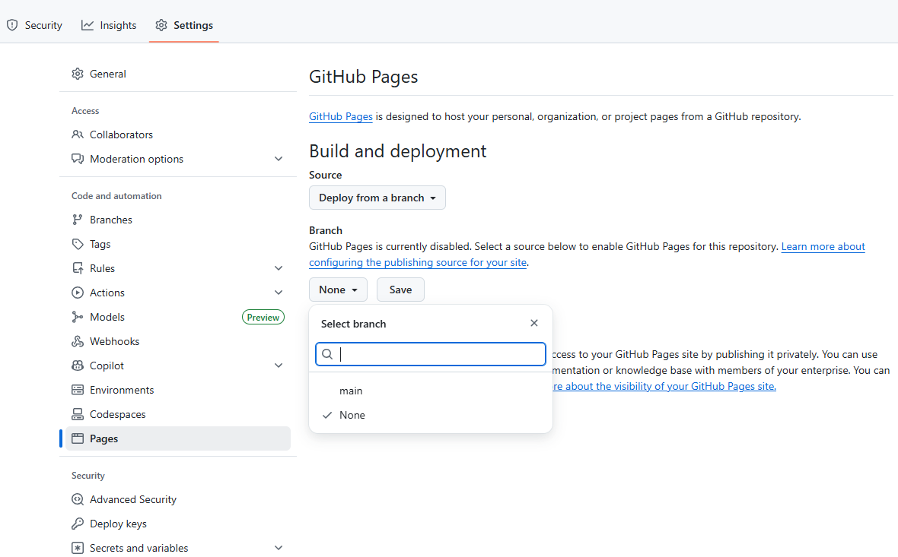
Hands-on!
Enable Github pages for your repo
Settings
Pages
Branch
“main”
Save

Slide 29
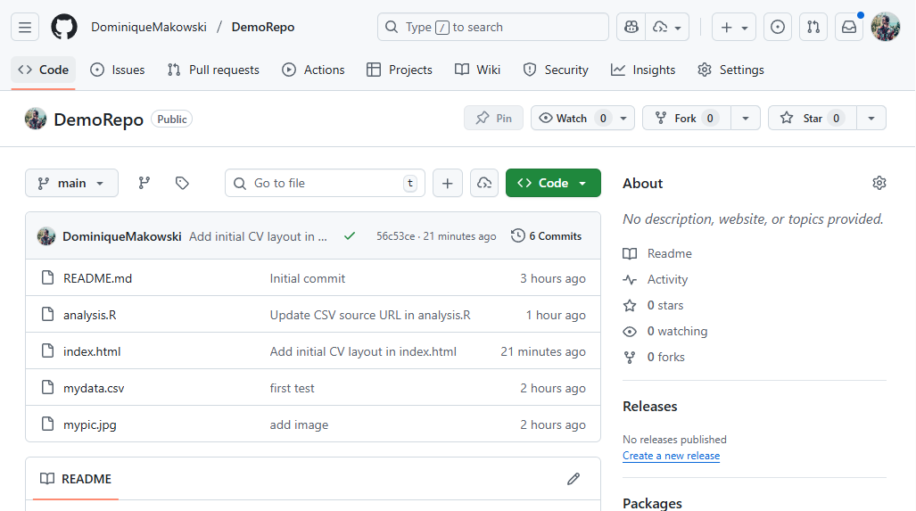
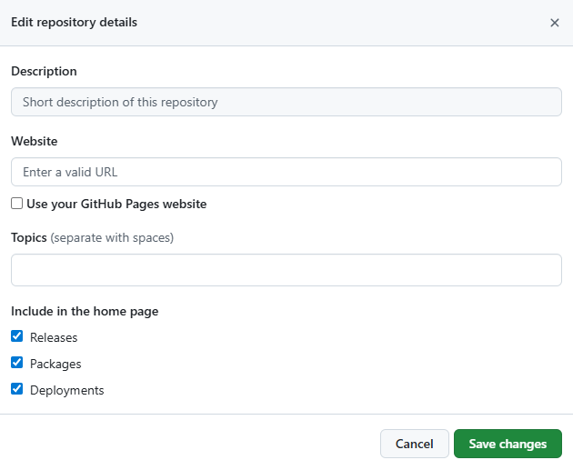
Github Pages
Webpages take a few seconds to be updated
You access the web view by a different URL
Convenient to have that link in the repo’s « about » box
Click on the box edit wheel icon
Tick « use your GitHub Pages website »
Save
Note: The URL of the website is different from that of the repo
Repo:
https://github.com/UserName/RepoName
Website:
https://UserName.github.io/RepoName/
= https://UserName.github.io/RepoName/index.html

Slide 30

Examples
You can use GitHub for any research & non-research related projects
Online CV
https://dominiquemakowski.github.io/ (outdated)
Note: I highly recommend having an online presence as an ECR
Projects meant to be websites only
https://dominiquemakowski.github.io/NeuropsyXart/
Projects including a website (or multiple)
https://dominiquemakowski.github.io/Music/tabs/
Source: https://github.com/DominiqueMakowski/Music
Note: see that the website is contained in one subfolder (/tabs/)
Random documents & info
https://github.com/RealityBending/Onboarding
Note: Making use of the README as an editable public info doc
Calendar
https://github.com/RealityBending/Calendar
Note: README updated daily generated automatically by Github Actions

Slide 31
Hands-on!
Download report.qmd from DominiqueMakowski/DemoRepo
Open it in R Studio
Render it
Upload the rendered .html on your repo
Wait a few seconds, & view it via github pages
The GitHub pages’ default URL points to the root of the repo
Looks for “index.html” if no specific file is specified
You can view any file by pointing at it through the URL

Slide 32

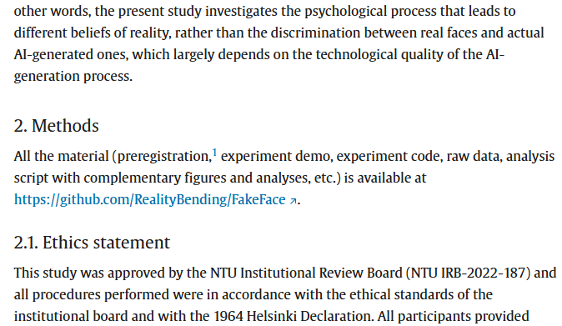
Open Science
Open science is a general philosophy, and adopting it usually means embracing tools that work seamlessy together
Quarto is a system that converts analysis scripts into accessible html pages
HTMLs pages can be hosted for free on GitHub
You can easily share your analysis script (code & results) by linking to the page
Avoid the need to attach tons of docs as annexes

Slide 33
Part 3
Community (profiles, stars, issues, network)

Slide 34
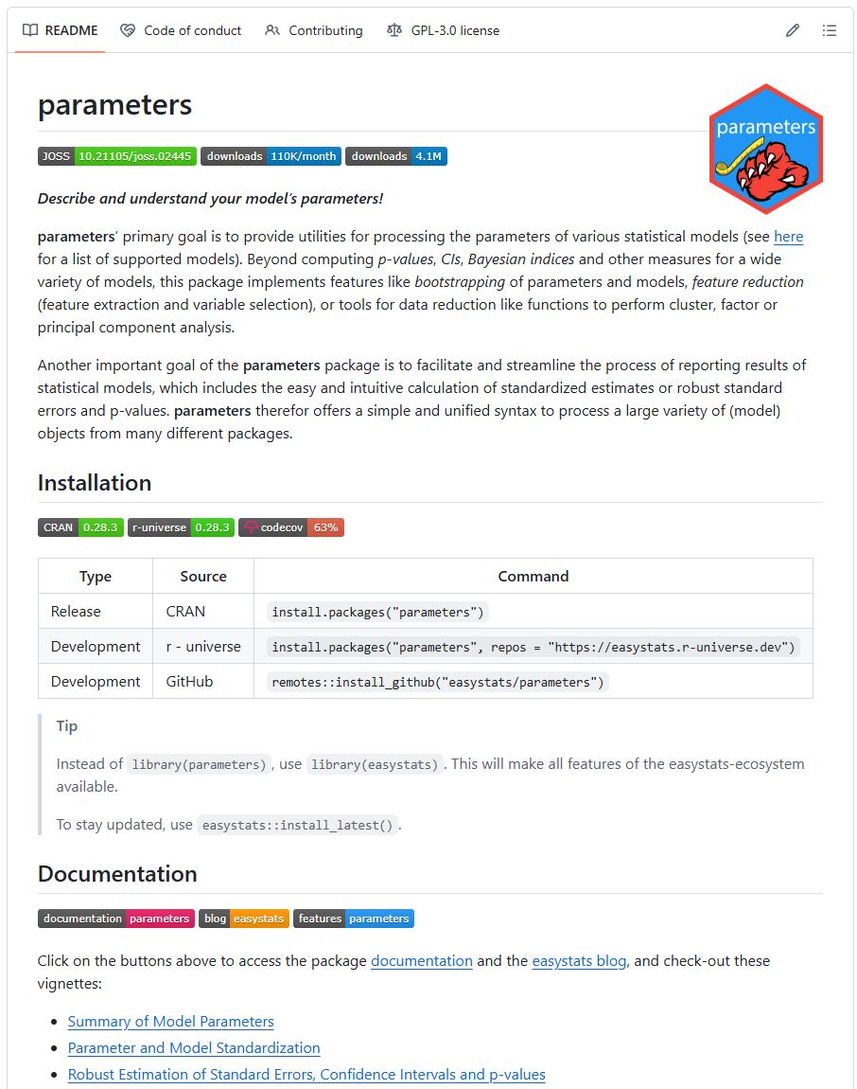
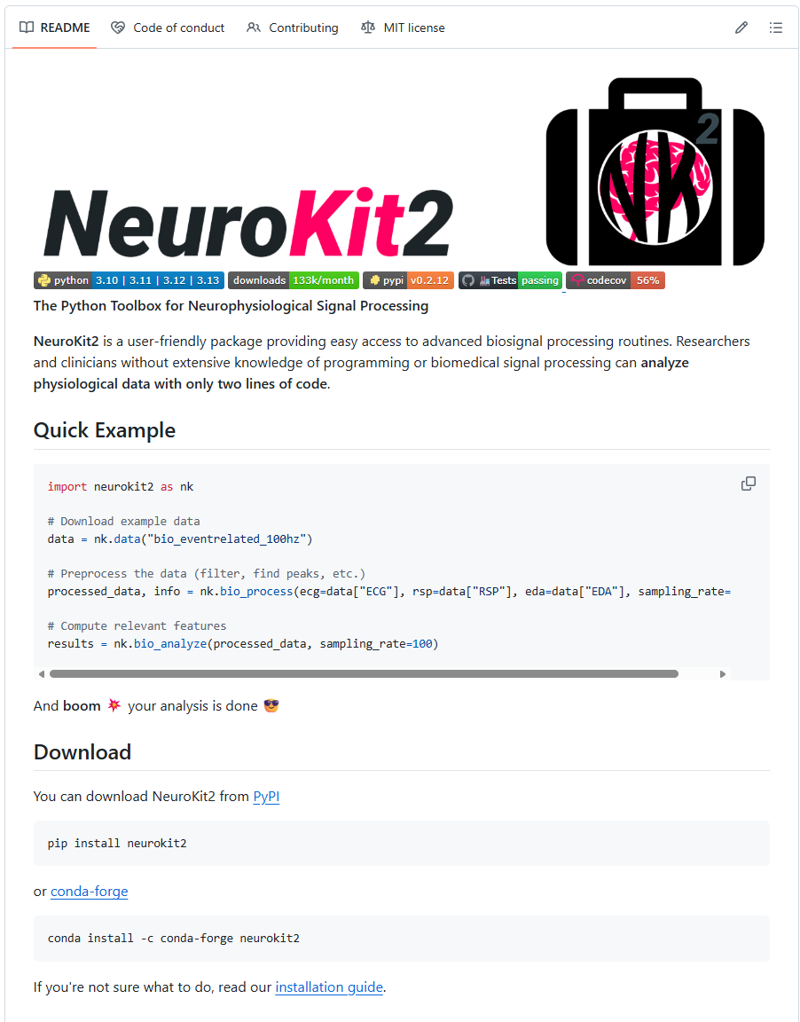
READMEs
The README is the window of your repo
Should contain:
Description of the repo
Useful info (how to use)
Useful links (e.g., to documentation)
The content is written in Markdown
Quick formatting language
Becoming used everywhere
Quarto
Reddit
Discord
…

Slide 35
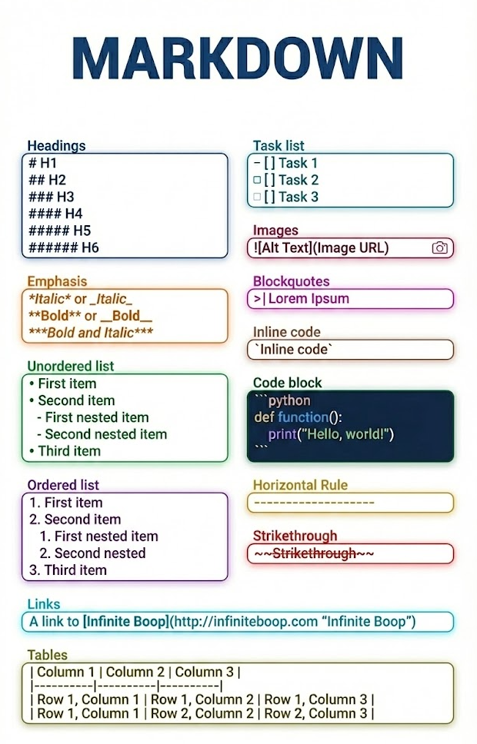
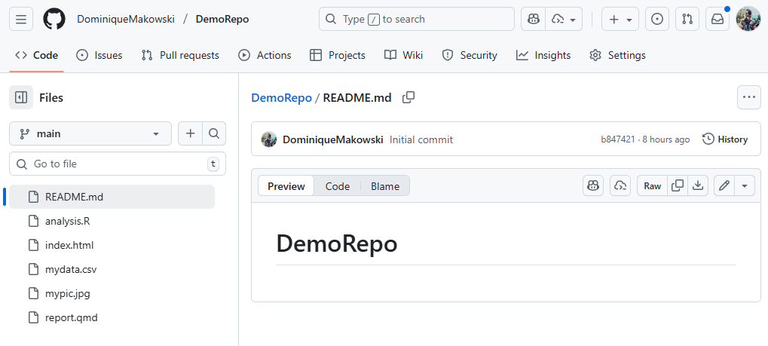
Hands-on!
Go to your README.md file
Click on edit (pen icon)
Add some markdown features
Heading
Link
List
Block of code
Commit

Slide 36

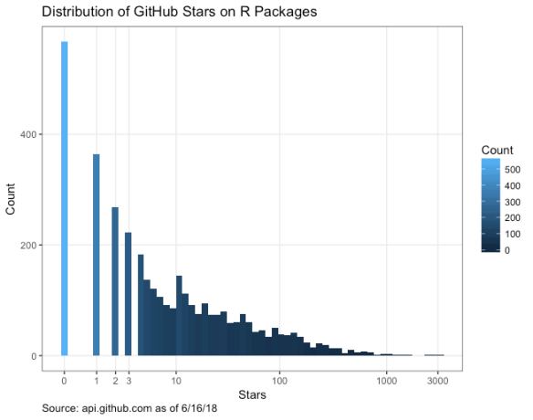
Star, follow, and network
GitHub is a « social » network
⭐ You can star repos:
It saves it in your lists of “favourites” (useful to mark a repo that might be useful for the future)
GitHub “cred” is often measured in stars
👣 You can follow people to see what they are up to
See repos they create, questions they ask, repos they star
👣 You can follow repositories
Be notified of every new changes / updates
Useful to keep up with active development in some packages or tools
Issues are one of the most useful GitHub feature
🫶 For users
Ask questions
Report bugs
Suggest features
Get in touch with developper
For developpers
To-do list
Keep track of things to adress

Slide 37
Hands-on!
Person A: Create an issue on your right neighbour (person B) with a link to your repo
Person B: Star ⭐ this repo and follow 👣 person A

Slide 38
Profile Readme
Good to have a curated profile
Profile pic
Information
Profile README
Each account can make a special repositories for which the README will be displayed as the profile README
The name of the repository matches the name of the account
E.g., https://github.com/DominiqueMakowski/DominiqueMakowski
Accounts to follow:
https://github.com/debruine
https://github.com/doomlab
https://github.com/profandyfield
…

Slide 39
Hands-on!
Make a cool profile

Slide 40
Part 4
Pull Requests

Slide 41
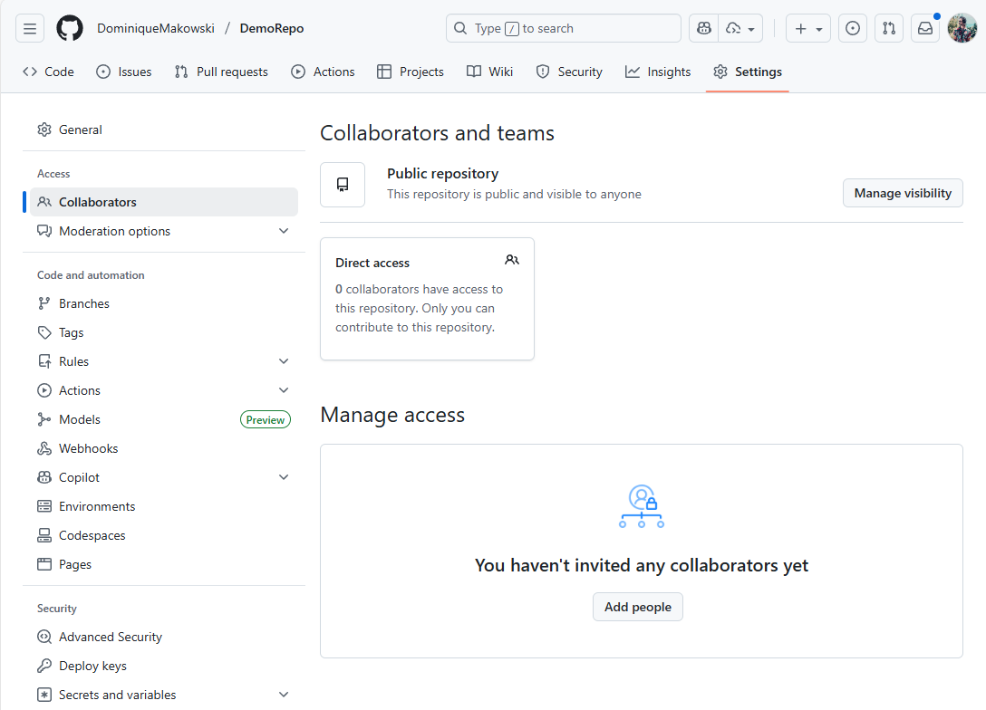
Collaborators
By default, the owner of the repo has full « write » access
You can other collaborators with various degrees of access
« write access » means people can directly edit
Useful for private projects or projects with close collaboration
GitHub is designed for large scale collaboration
Anybody can « suggest » edits to a public repo
This process is known as PULL REQUESTS (PRs)

Slide 42
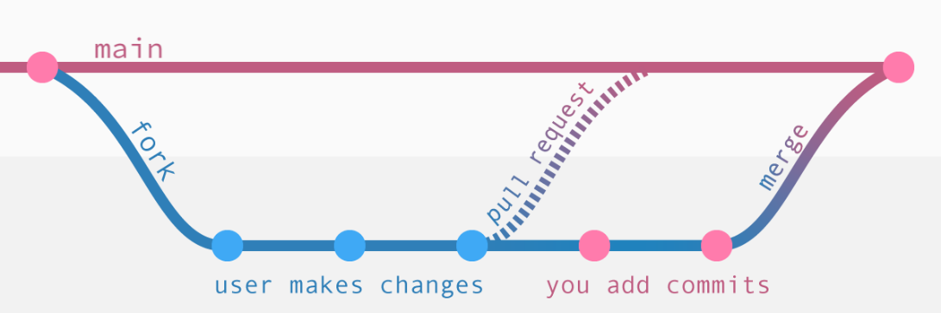


Forking & Pull requesting

Slide 43
Hands-on!
Make a PR to add a funny image on your friend’s README

Slide 44
Hands-on!
Create a conflict

Slide 45
Commit History
View commit history
You can go back at any time of the history of the repository

Slide 46
Part 4
Interacting locally

Slide 47
Part 5
Collaboration (forks, PRs, branches…)

Slide 48

Thank you
Dominique Makowski
D.Makowski@sussex.ac.uk

